Slide 1



The IMPACT OF CORONAVIRUS
& the data to help you.

Slide 2

Objective
Our Approach
Findings
Future Opportunities

Slide 3

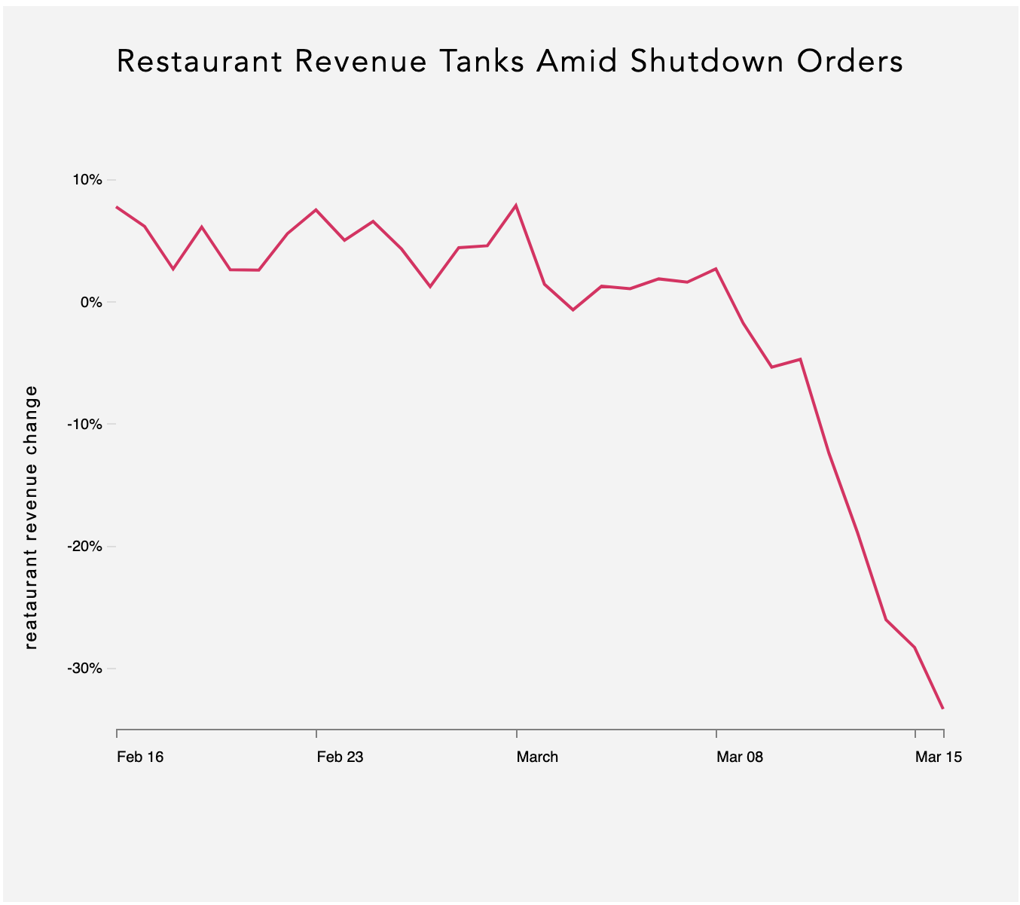
10%
0%
-10%
Restaurant Revenue Change
-20%
-30%
Feb 16
Feb 23
March
March 8
March 15
2020
Source: Womply

Slide 4
PROBLEM
HOW WE HELP
Loss of foot-traffic =
Loss of business.
You have revenue numbers, but you need foot-traffic numbers to support why revenue is low.
When you request government funds to support your members,
we can give you powerful data
to back your demands.

Slide 5

OUR APPROACH
GET MTA NUMBERS
EXAMINE & ‘CLEAN’ DATA
ANALYZE
NUMBERS
For the 10 busiest stations, we pulled MTA’s January - June numbers for 2020, 2019, and 2018
MTA’s raw data is very raw. We cleaned it up without sacrifice to confidence in data’s accuracy
Using statistical calculations and graphs, we compared 2020 traffic to 2019 & 2018

Slide 6
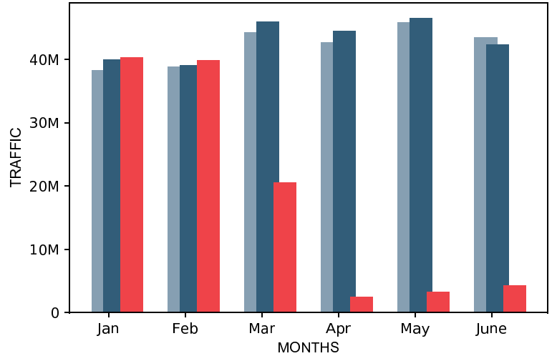
MTA MONTHLY TRAFFIC FOR TOP 10 busiest subway STATIONS*
2018
2019
2020
*Top 10 busiest subway stations according to 2019 MTA report

Slide 7
BY THE NUMBERS ApRIL - JUNE
-92%
Overall drop in
traffic 2020 from 2019
ENTRIES
EXITS
70M
64M
2019
2019
4.5M
5.6M
2020
2020

Slide 8
BY THE NUMBERS ApRIL - JUNE
Not normally included in ‘ridership’ numbers for MTA
-92%
Overall drop in
traffic 2020 from 2019
ENTRIES
EXITS
70M
64M
2019
2019
4.5M
5.6M
2020
2020

Slide 9
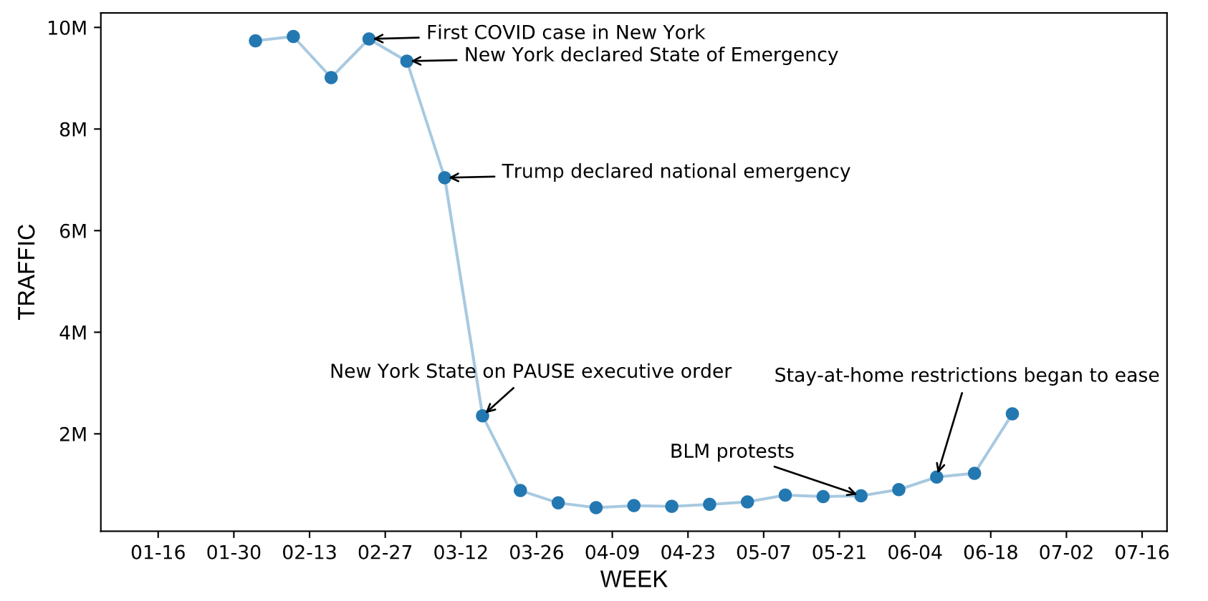
Traffic Trends + Major events affecting nyc residents in 2020

Slide 10
FUTURE OPPORTUNITIES
Expand from top 10 stations to all MTA stations
If helpful, we have data by-week available
Develop an interactive map for your members to easily search for specific station stats near them
Pair this data with your business’s revenue numbers for 2018, 2019, and 2020 to determine exactly how strong the correlation is between revenue decline and foot-traffic decline

Slide 11

THANK YOU
The Metis Data Science Agency
Joseph Grovers
Celina Plaza
Cynthia Wang

Slide 12

APPENDIX

Slide 13
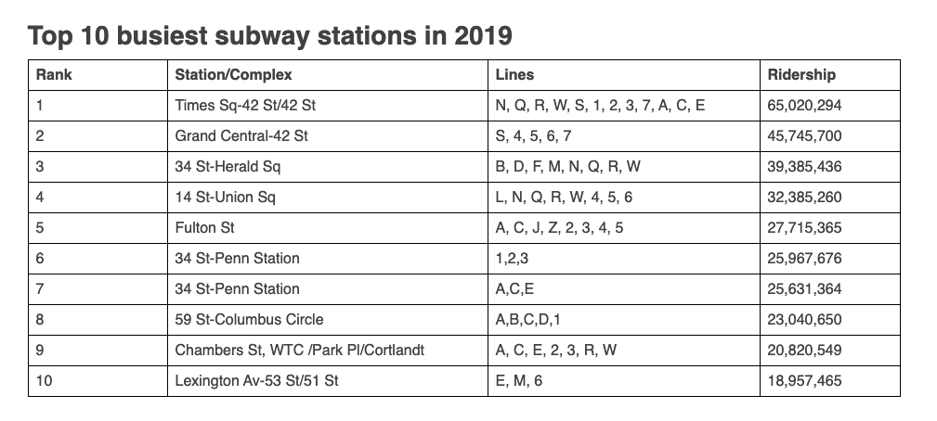
MTA Top 10 Stations
Source: MTA

Slide 14
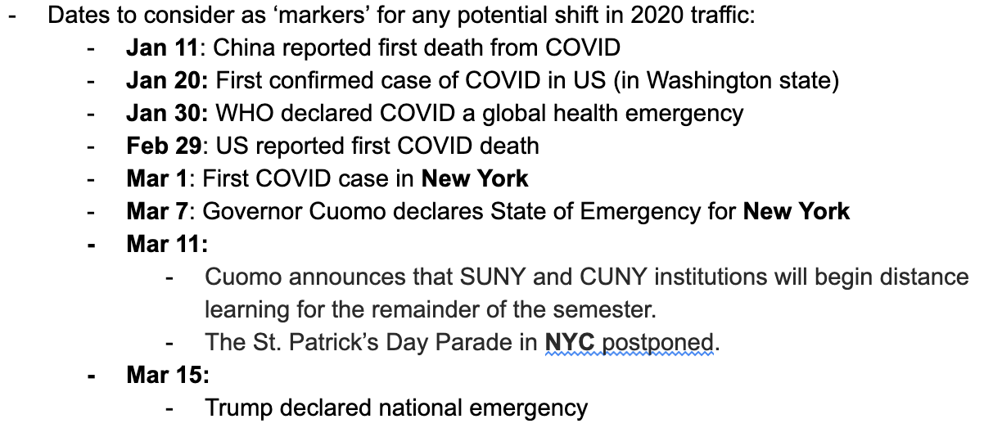
MAJOR NYC EVENTS IN 2020 RELATED TO COVID & PROTESTS
Source: NYT & Syracuse.com & nbcnewyork.com & npr

Slide 15
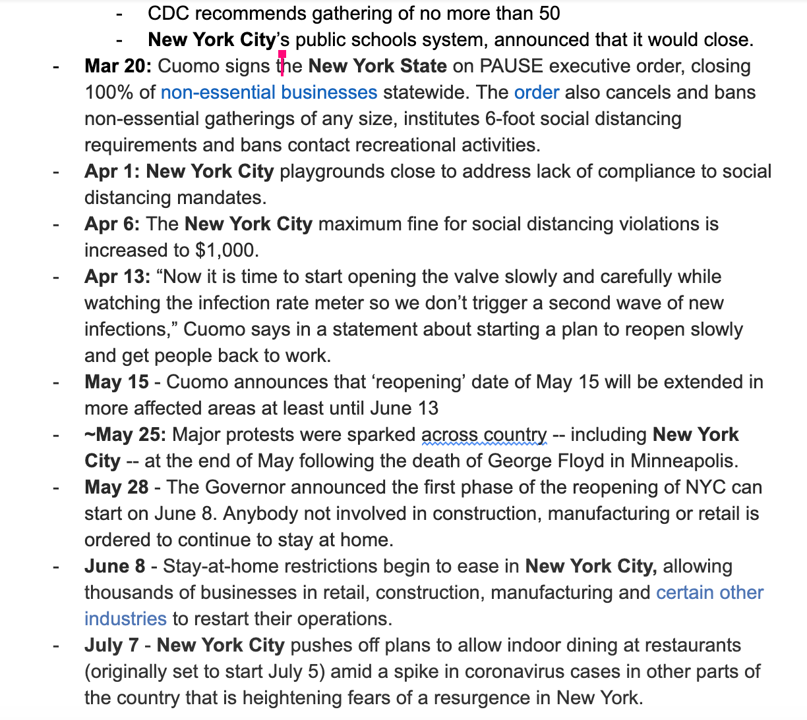
MAJOR NYC EVENTS IN 2020 RELATED TO COVID & PROTESTS
Source: NYT & Syracuse.com & nbcnewyork.com & npr

Slide 16
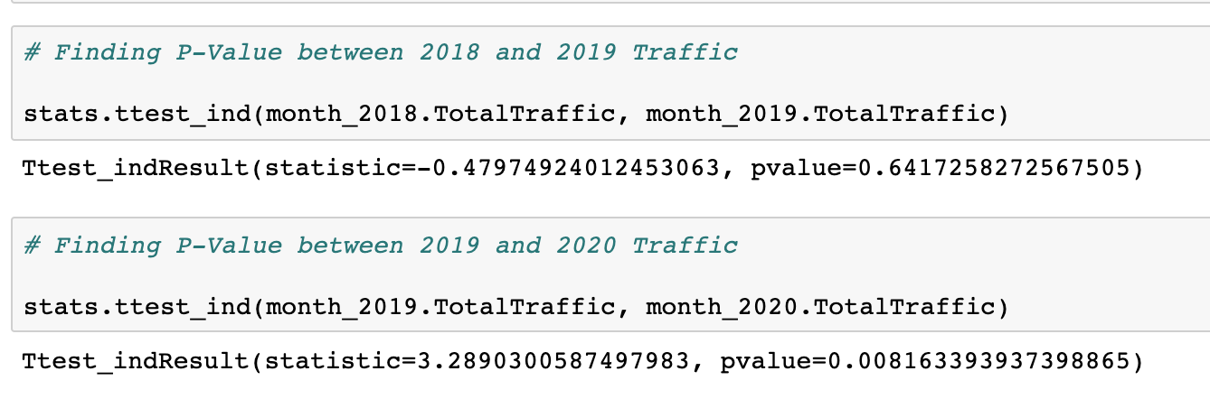
T-Tests to find P-Values between years’ Traffic

Slide 17
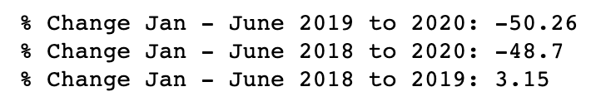
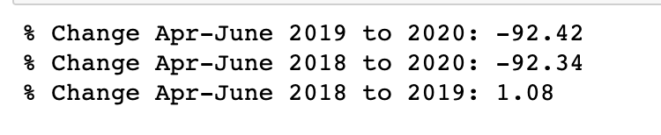
PERCENT CHANGES FOR SPECIFIC PERIODS Year over year

Slide 18
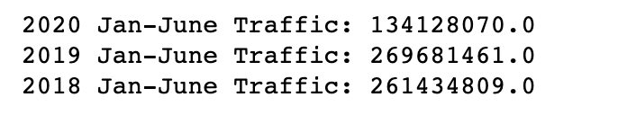
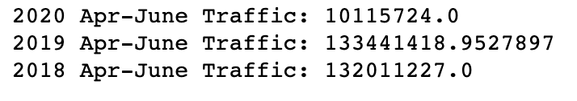
TRAFFIC NUMBERS FOR CERTAIN DATE RANGES

Slide 19
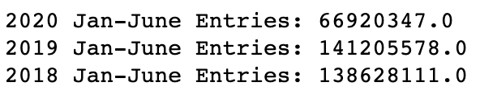
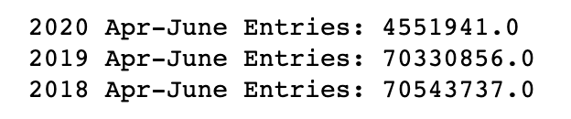
ENTRY NUMBERS FOR CERTAIN DATE RANGES

Slide 20
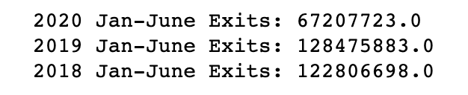
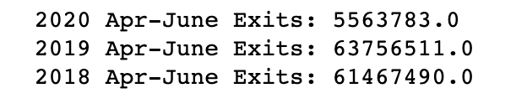
EXIT NUMBERS FOR CERTAIN DATE RANGES

Slide 21
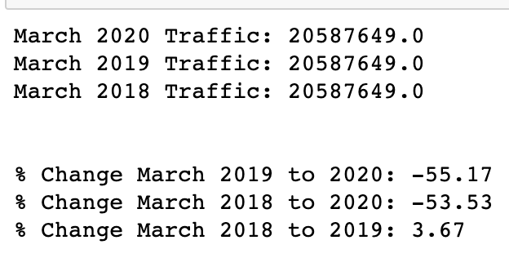
MARCH NUMBERS

Slide 22
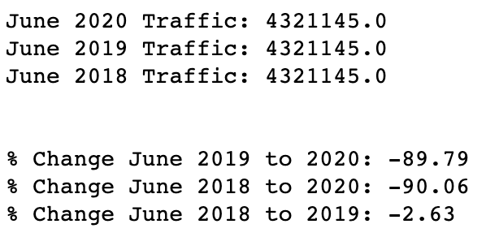
June NUMBERS

